Slide 1
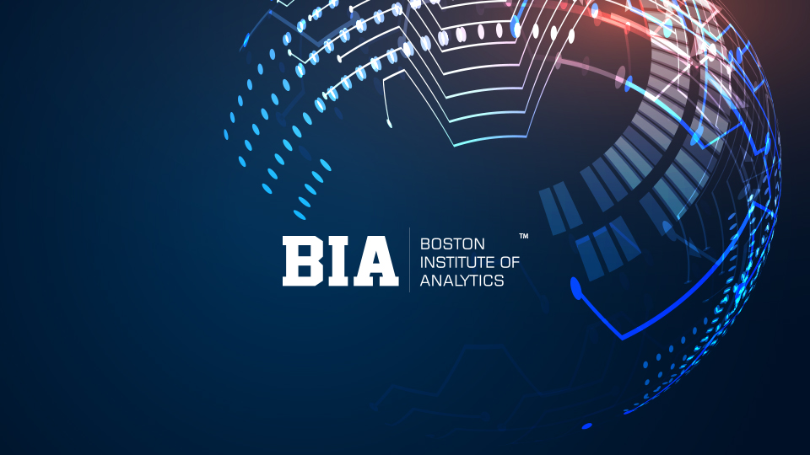

Slide 2
Trainer Guidelines for Conducting Class
Solve questions live by creating new blank files (Excel, Python, Jupyter notebook, Dashboard) during the session, rather than sharing completed solutions.
Review teaching materials and solutions beforehand, and prepare additional examples to reinforce learning.
Ensure online students can hear you and see the screen clearly at all times.
Test your computer and necessary software before class begins.
Check with online students every 15-20 minutes to see if they understand the material and have any questions.

Slide 3

Agenda: Advance NLP Techniques
Advanced Word Embeddings
GloVe (Global Vectors For Word Representation)
N-grams
Recurrent Neural Networks (RNN)
Long Short-term Memory (LSTM)
Practical Exercise
NLP in Real Word
Ethical Considerations & Future of NLP

Slide 4
Advanced Word Embeddings
Advanced word embeddings refer to more sophisticated and contextually aware word representation techniques which aims to capture richer and dynamic contextual information.
Traditional vs. Advanced Word Embeddings:
Traditional word embeddings like Word2Vec or GloVe are context-independent.
Advanced word embeddings, on the other hand, are context-dependent. They consider the context in which a word appears to determine its vector representation.

Slide 5
Introduction to GLOVE
GloVe, which stands for Global Vectors for Word Representation, is designed to capture the semantic meaning of words in a continuous vector space, often referred to as word vectors or word embeddings.
Word Embeddings:
Word embeddings are dense vector representations of words. Each word is mapped to a high-dimensional vector in a continuous vector space.
Co-Occurrence Matrix:
GloVe starts by constructing a co-occurrence matrix from a large text corpus. Each entry in this matrix represents how often a word appears near another word.
The rows and columns of this matrix correspond to words in the vocabulary.

Slide 6
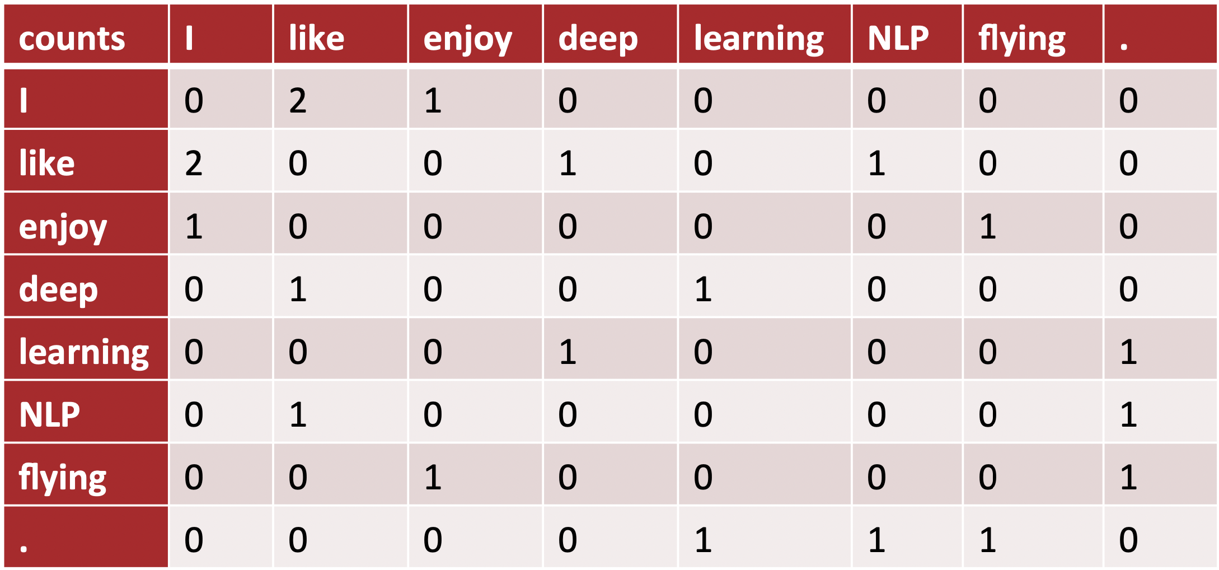
Co-Occurrence Matrix

Slide 7
Introduction to GLOVE
GloVe's optimization objective is it tries to minimize the difference between the dot product of two-word vectors and the logarithm of their co-occurrence count.
Application:
Once the GloVe model is trained, you have a set of word vectors that encode semantic information.
These word vectors can be used in various NLP tasks such as text classification, sentiment analysis, machine translation, and text generation.
Advantages:
GloVe captures global word co-occurrence information and tends to provide better semantic representations.
It has fewer hyperparameters to tune compared to some other methods.

Slide 8
N-grams
N-grams are contiguous sequences of n items from a given sample of text. In the context of natural language processing, these items are usually words, but they can also be characters or other linguistic units, depending on the application.
Types of N-grams:
Unigrams (1-grams): These are single words or tokens.
Bigrams (2-grams): These consist of pairs of adjacent words or tokens, such as "natural language.
Trigrams (3-grams): These contain sequences of three words, like "deep learning models,"
N-grams (N > 3): For larger values of N, you have n-grams containing more than three words, which can capture longer linguistic structures.

Slide 9
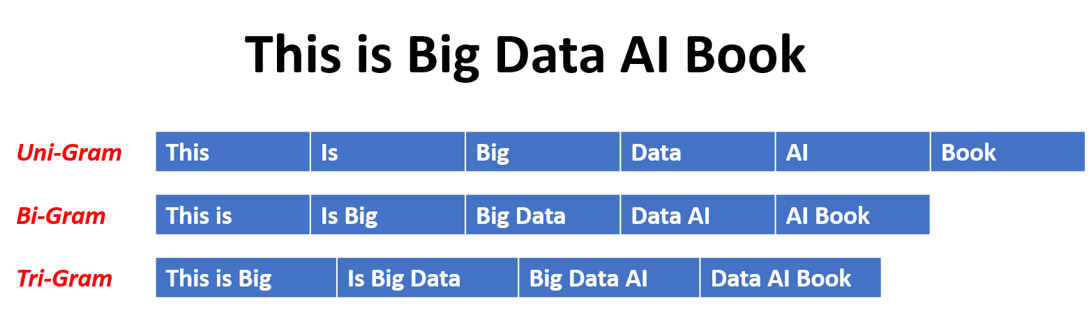
N-grams

Slide 10
Applications of N-grams
Language Modeling: N-grams are used in speech recognition, machine translation, and text generation.
Text Analysis: N-grams are valuable for extracting keywords, detecting collocations, and identifying recurring patterns in the text.
Information Retrieval: In information retrieval systems, search engines use N-grams to index and search for documents efficiently.
NLP Tasks: N-grams can be useful in various NLP tasks, such as sentiment analysis, part-of-speech tagging, and named entity recognition.

Slide 11
Recurrent Neural Networks (RNNs)
Recurrent Neural Networks (RNNs) are a type of artificial neural network designed for processing sequential data. They are used in natural language processing, time series analysis, and speech recognition.
Basic Structure:
RNNs are characterized by their recurrent or looped structure. This structure enables the network to capture temporal dependencies within the data.
Sequential Data Processing:
RNNs excel in handling sequences of data where the order matters. This could include time series data, text, audio signals, and more.
Each element of the sequence is processed one at a time, and the network maintains a hidden state that carries information from one time step to the next.

Slide 12
LSTM (Long Short-Term Memory)
LSTM is an RNN architecture for handling long sequences and mitigating vanishing gradient problems.
Long-Term and Short-Term Memory Cells: LSTMs have long-term (c) and short-term (h) memory cells for retaining and managing information.
Gate Mechanisms: LSTMs use three gate mechanisms:
Forget Gate: Decides what to forget from long-term memory.
Input Gate: Determines what to store in long-term memory.
Output Gate: Regulates information for short-term memory and output.

Slide 13
LSTM (Long Short-Term Memory)
Update and Reset Gates:
Update Gate: Controls how much current short-term memory is added to long-term memory.
Reset Gate: Decides how much of the previous long-term memory to forget.
Equations and Pictorial Representation: LSTMs are defined by equations describing information flow, and diagrams illustrate gate and memory cell interactions.

Slide 14
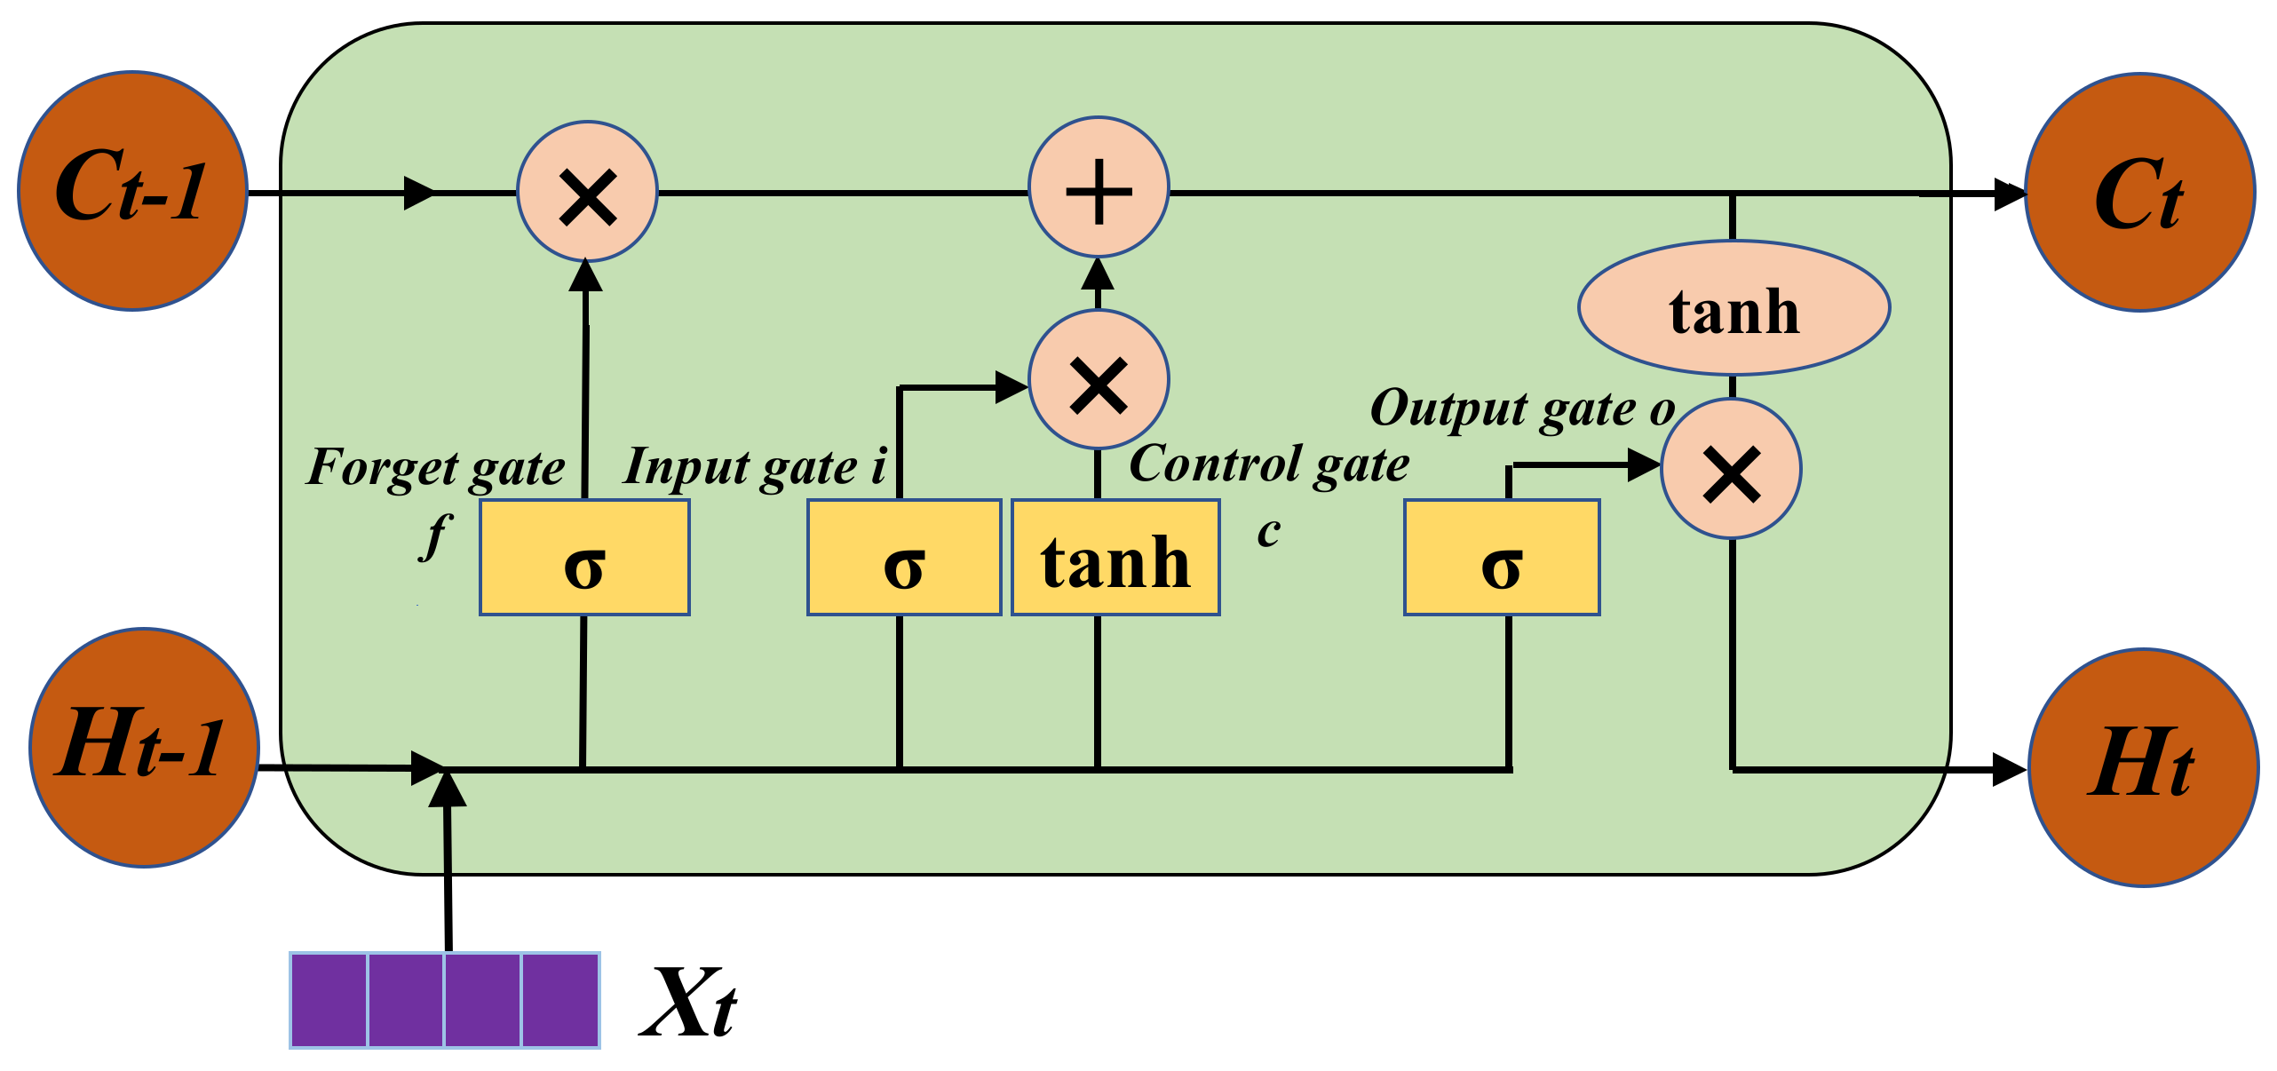
LSTMs (Long Short-Term Memory)

Slide 15
LSTMs (Long Short-Term Memory)
Role of Activation Functions:
Activation functions (e.g., sigmoid and tanh) are used in gates to control the amount of information passed.
They introduce non-linearity, enabling the network to capture complex patterns.
Comparison with Traditional RNNs:
LSTMs mitigate vanishing gradients and capture long-range dependencies.
Traditional RNNs lack these capabilities.
Use Cases for LSTMs:
Natural Language Processing, Speech Recognition, Time Series Analysis, Video Analysis, among others.

Slide 16
GRU(Gated Recurrent Unit)
GRUs are a variation of RNNs & known for handling sequential data effectively.
A GRU unit is similar in structure to a long short-term memory (LSTM) cell, another type of RNN cell.
GRUs consist of several gates and an internal state that helps the network maintain and update information over time.
Gates:
Update Gate (z): Manages what to keep from the previous state.
Reset Gate (r): Handles what to forget from the current state.
New Memory Content: Contains information to be incorporated into the memory.

Slide 17
GRU(Gated Recurrent Unit)
Operation:
At each time step, the GRU unit calculates these gates and updates its internal state and memory.
The update gate (z) determines how much of the previous state to keep and how much of the new candidate state to add.
The reset gate (r) decides which parts of the current state to forget.
The new memory content is then combined with the previous state to form the updated state.

Slide 18
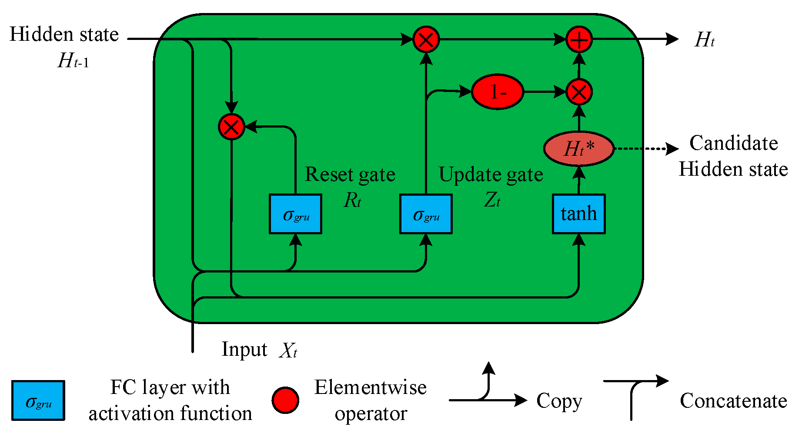
GRU(Gated Recurrent Unit)

Slide 19
Hands-on: ADVANCED NLP TASKS
Fake & Real news Dataset: This dataset consists of about 40000 articles consisting of fake as well as real news. Our aim is to train our model so that it can correctly predict whether a given piece of news is real or fake. The fake and real news data is given in two separate datasets with each dataset consisting around 20000 articles each.
Note: Use google colab to run the code.

Slide 20
NLP in Real World
Chatbots: NLP powers automated chat systems for customer support and information retrieval.
Sentiment Analysis: NLP analyzes social media data to gauge public sentiment about products and services.
Language Translation: NLP facilitates automatic translation between languages, like Google Translate.
Healthcare Records: NLP extracts insights from medical records for diagnosis, monitoring, and research.
Legal Document Summarization: NLP automates the summarization of lengthy legal documents.
Text Classification: NLP is used for tasks like spam detection and news categorization.
Language Understanding: NLP enables voice assistants to understand and respond to spoken commands.
Autocorrect and Autocomplete: NLP assists users in writing more accurately and efficiently.
Recommendation Systems: NLP personalizes product, movie, and content recommendations.
Content Generation: NLP models can generate human-like text for content creation.

Slide 21
Ethical Considerations
Privacy and Data Protection:
Safeguard user data and privacy.
Implement data anonymization and consent mechanisms.
Fairness and Bias in NLP Models:
Address and mitigate bias in model outputs.
Ensure diversity and representativeness in training data.
Responsible AI Principles:
Adhere to principles of transparency, accountability, and explainability.
Regularly audit and evaluate models for ethical compliance.

Slide 22
Future of NLP
Advanced Deep Learning Models:
More context-aware and powerful NLP models like GPT-4.
Multilingual NLP:
Improved language understanding for diverse languages.
Domain-specific NLP:
Tailored NLP for specific industries.
Conversational AI:
Human-like chatbots and virtual assistants for better interactions.

Slide 23
Questions ?

Slide 24
Thank You !

